Slide 1


SHIELD INSURANCE ANALYSIS
AMAL KURIYAN

Slide 2
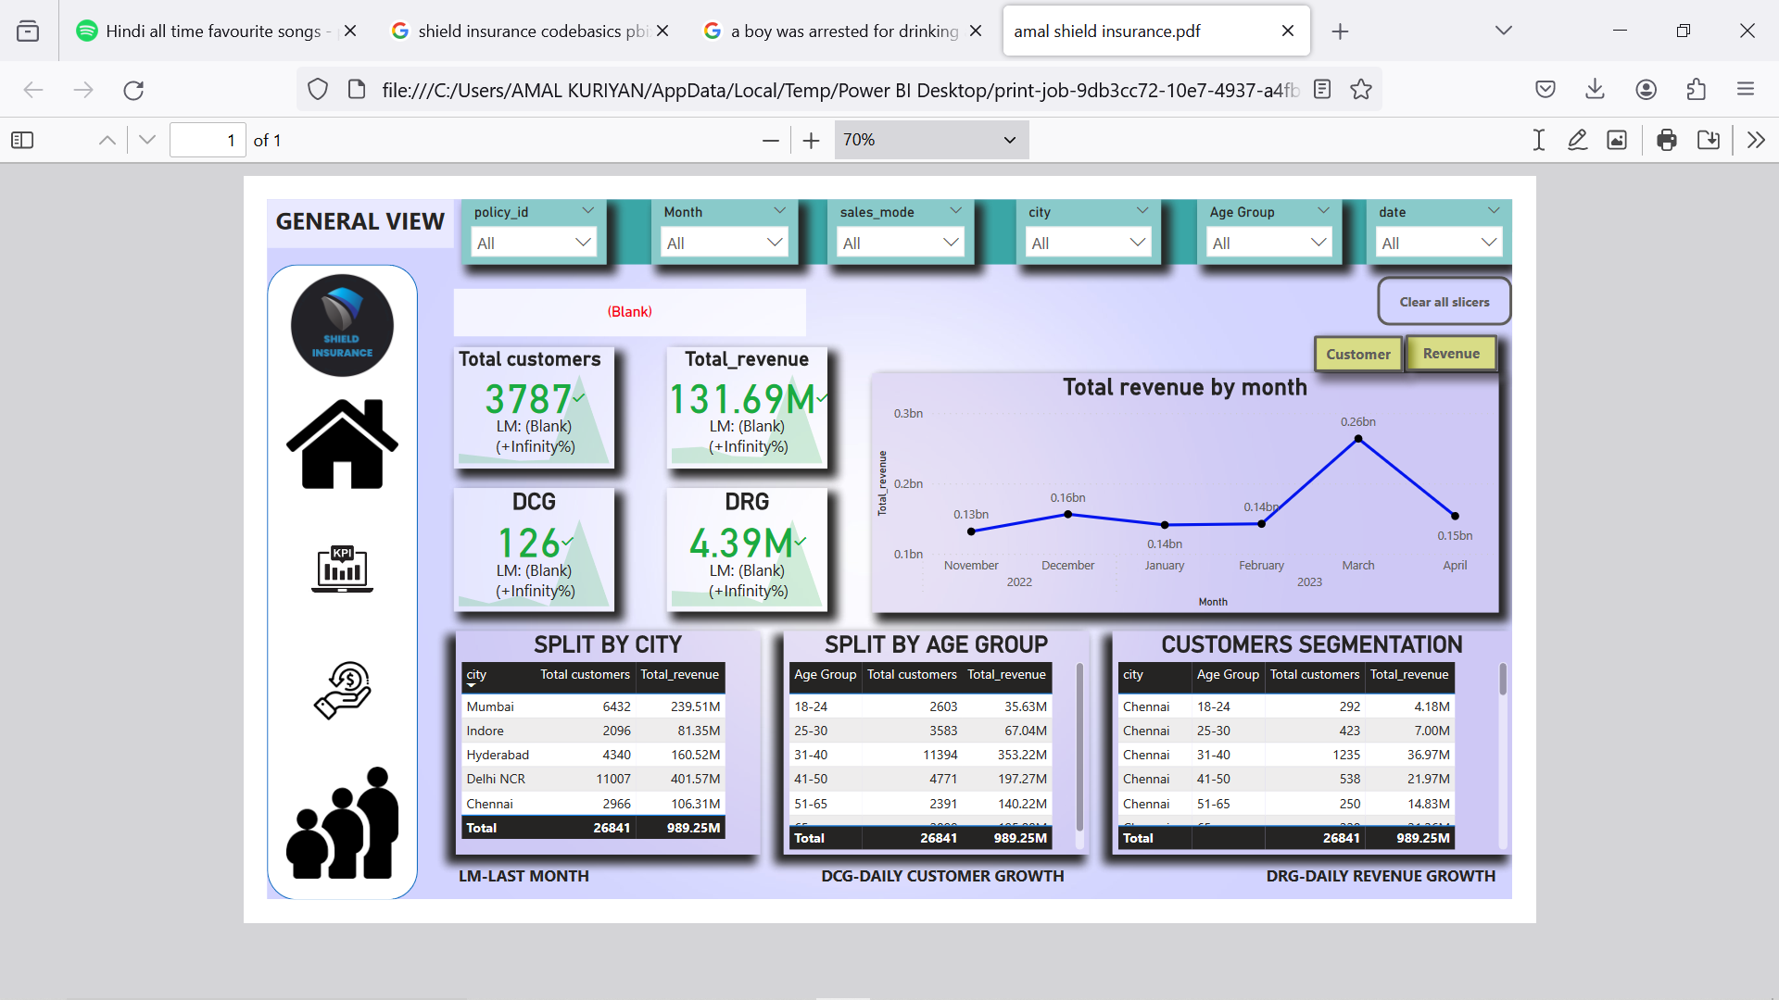
POWERBI DASHBOARD

Slide 3
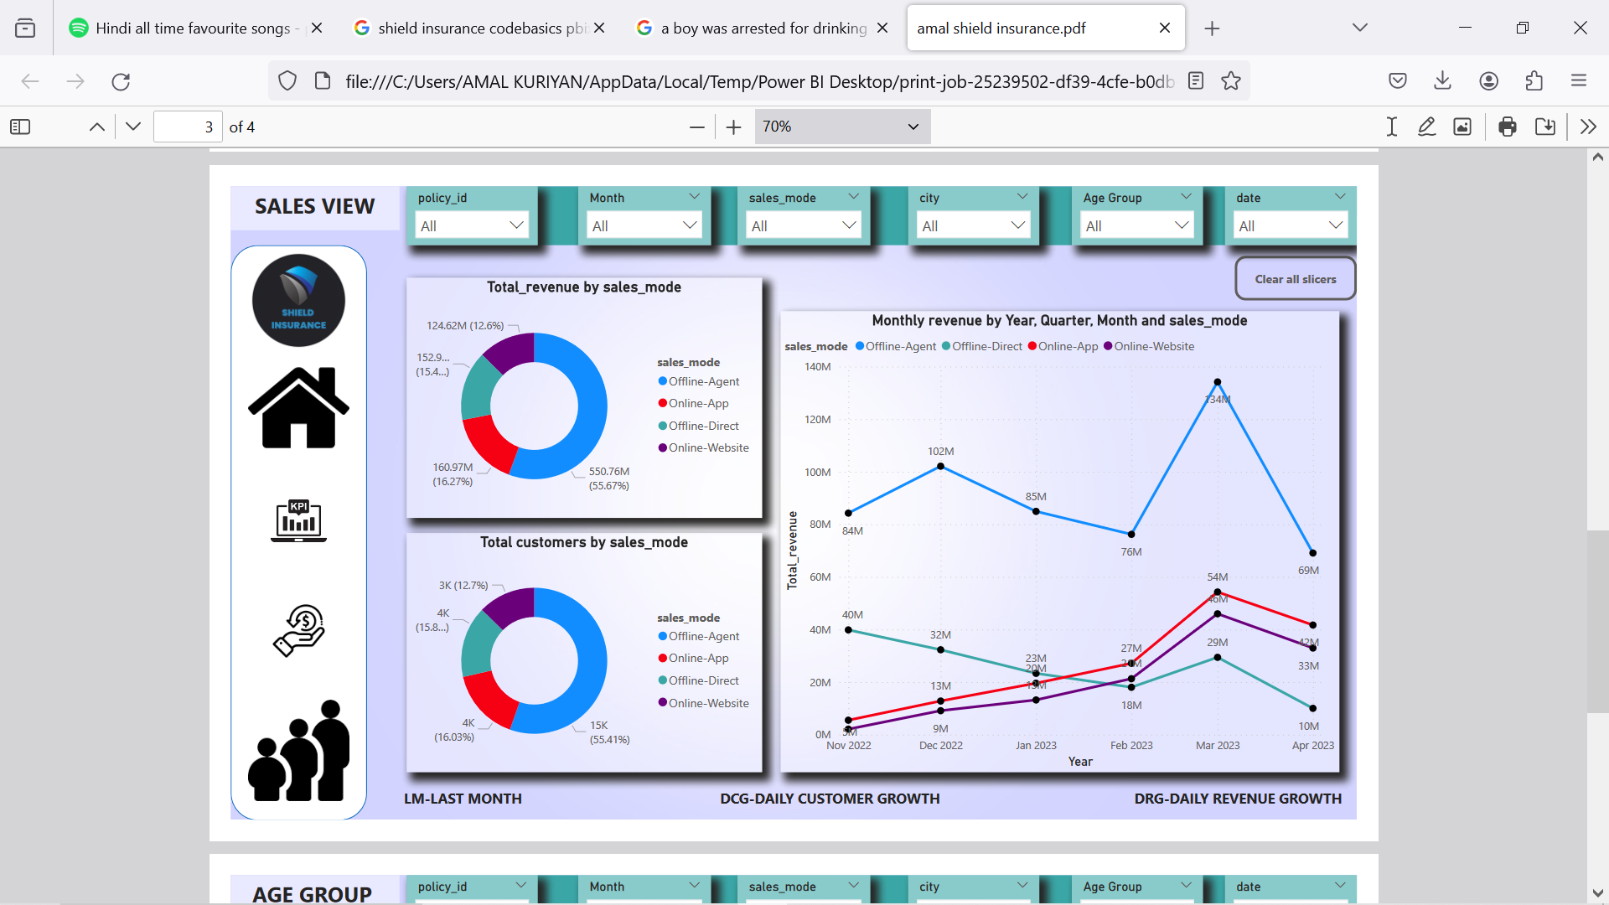
POWERBI DASHBOARD

Slide 4
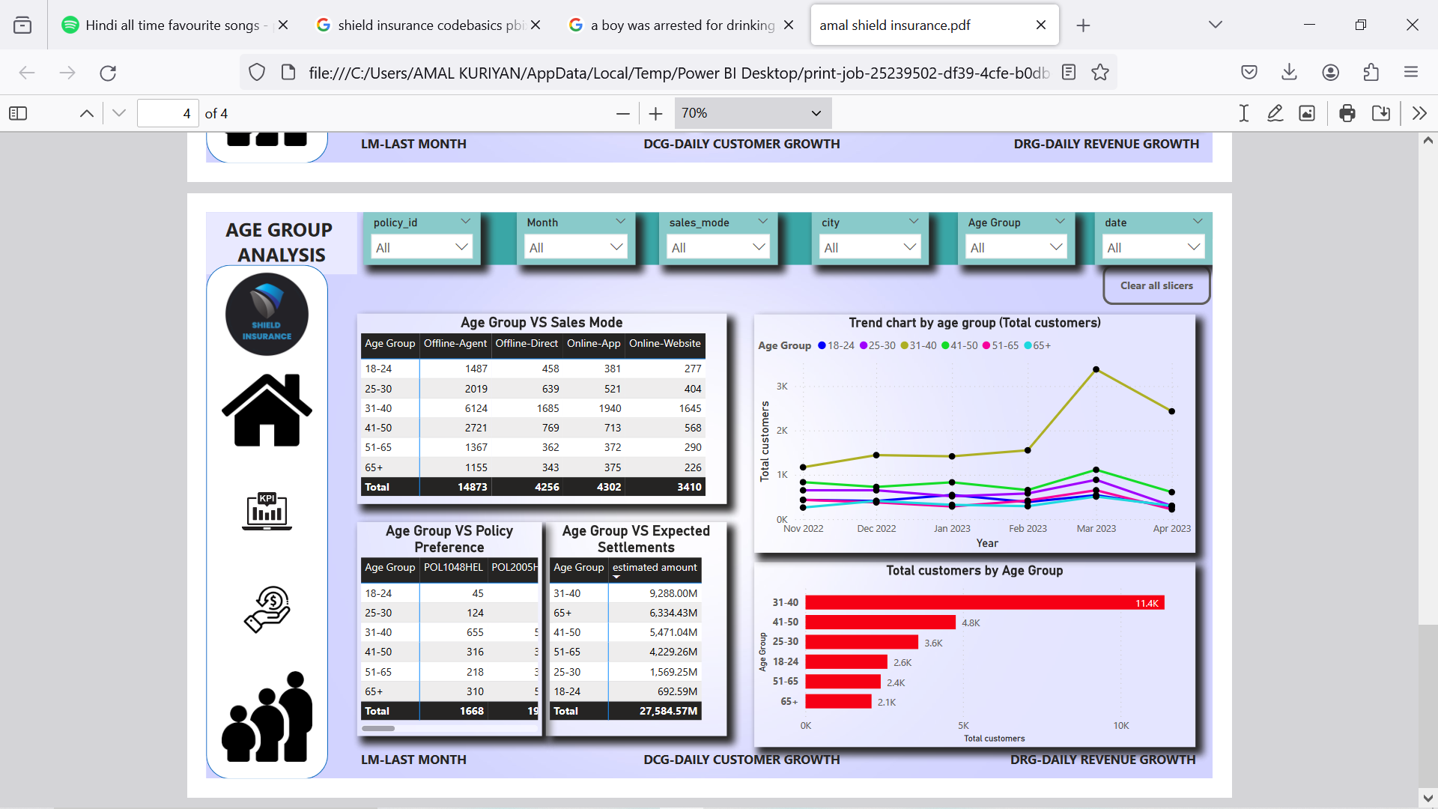
POWERBI DASHBOARD

Slide 5
PROJECT OVERVIEW
COMPANY OVERVIEW
Shield Insurance is a leading provider of insurance products and financial services, dedicated to helping individuals and businesses mitigate risks and secure their futures.
With a strong commitment to customer satisfaction, innovative products, and sound financial management, Shield insurance has established itself as a trusted partner in the insurance industry
As a Data Analyst Intern my primary objective is to contribute to the understandings of the company’s operations , customer dynamics and overall performance.
This analysis is based on the data provided by the company during the period of November 2022 to April 2023.
The project seeks to analyze customer churn patterns and develop strategies to mitigate customer attrition.

Slide 6
DATA OVERVIEW
Total Revenue - 989.25Million
Total Customers- 26841
Operational Cities- Chennai,Delhi,Hyderabad,Indore and Mumbai
Age Categories- 18-24,25-30,31-40,41-50,51-65 and 65+
Policies- Nine Policies
Sales Mode- Offline(Agent,Direct) , Online(App,Website)

Slide 7
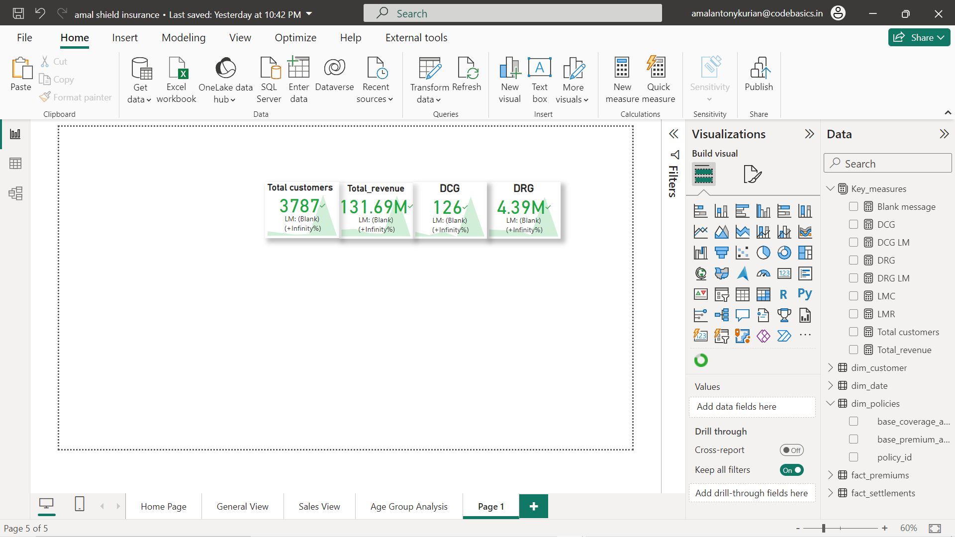
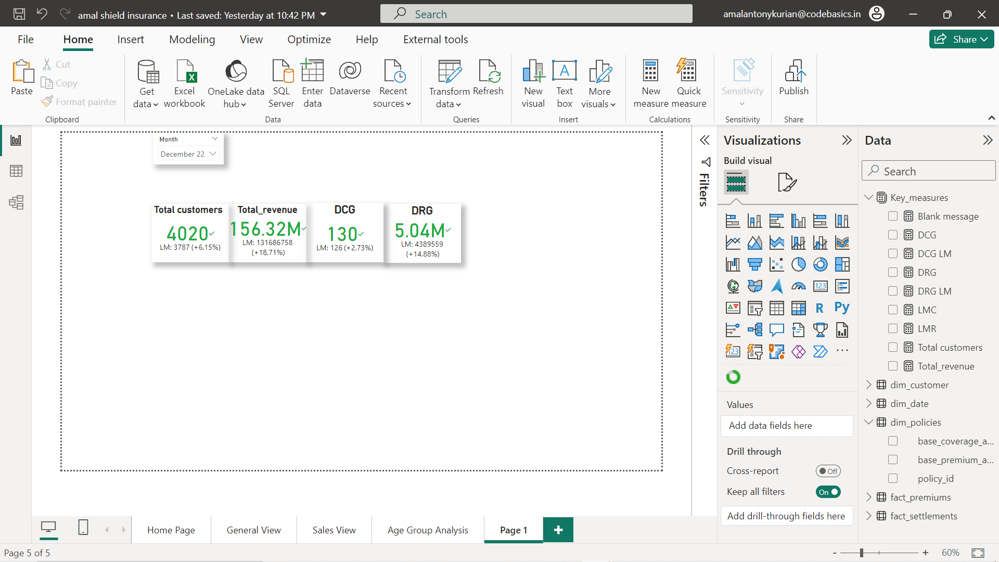
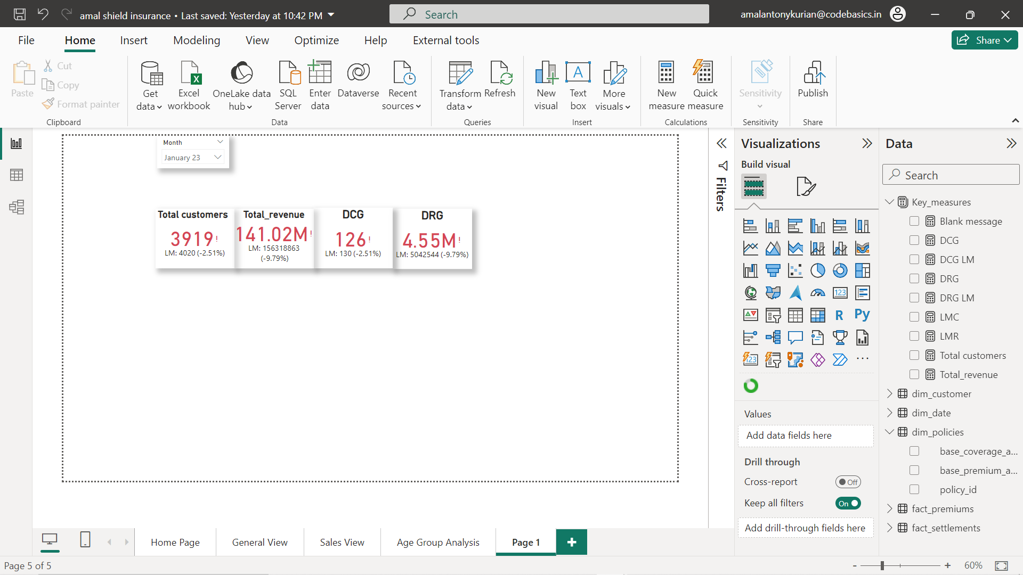
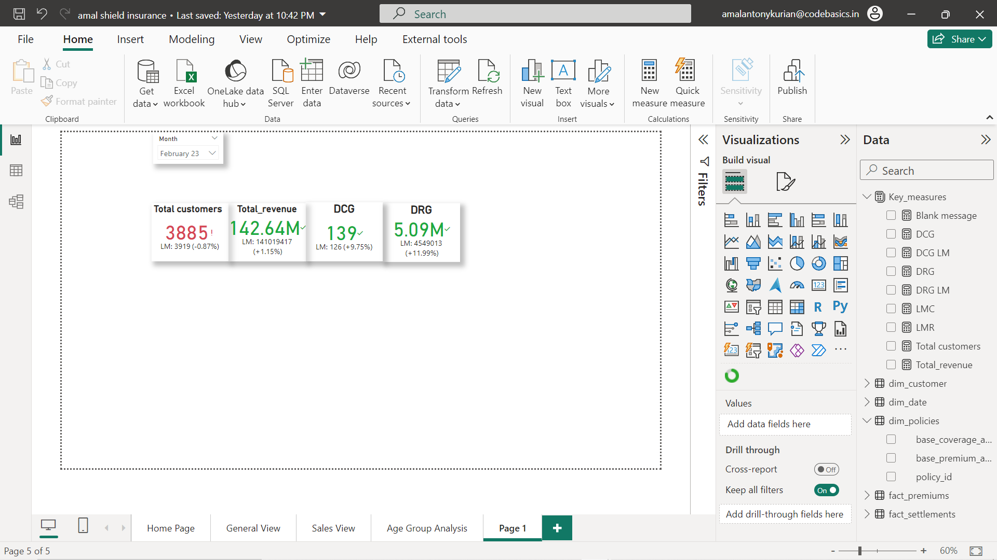
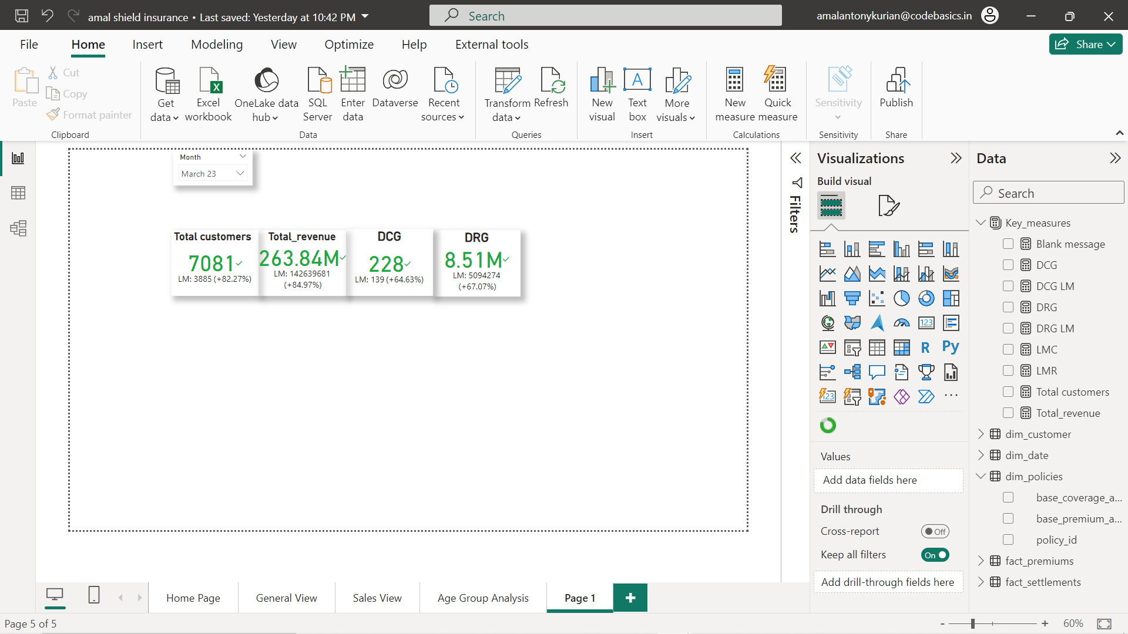

KEY INSIGHTS
KPI ANALYSIS
In the month of November 2022 the total no.of customers is 3787 and the revenue generation is 131.69M.This month showed the lowest total customers and total revenue.
In the month of December 2022 every kpi’s showed a increase compared to the previous month,the total customers rose to 4020 and the revenue increased to156.32M.
In the month of January 2023 every kpi’s went down compared to the previous month.The total customers declined and revenue generation also declined.There is also a decline in DCG and DRG.
In the month of February 2023 comparing to the previous month except total customers all other kpi’s showed an increase,while there is a decline in the no.total customers.
March 2023 showed a tremendous growth out of all months.The total customers and revenue generation suddenly boomed to higher figures.
Compared to the previous month the kpi’s showed negative growth but comparing to al other months the growth is on the higher side.
NOV22
DEC22
JAN23
FEB23
MAR23
APR23

Slide 8
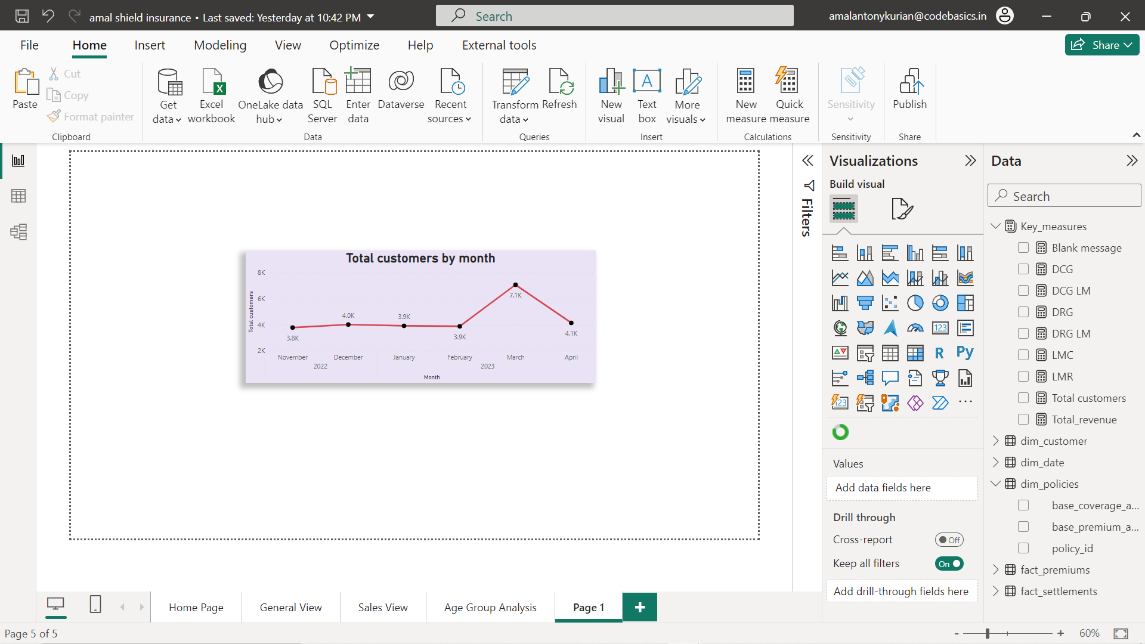
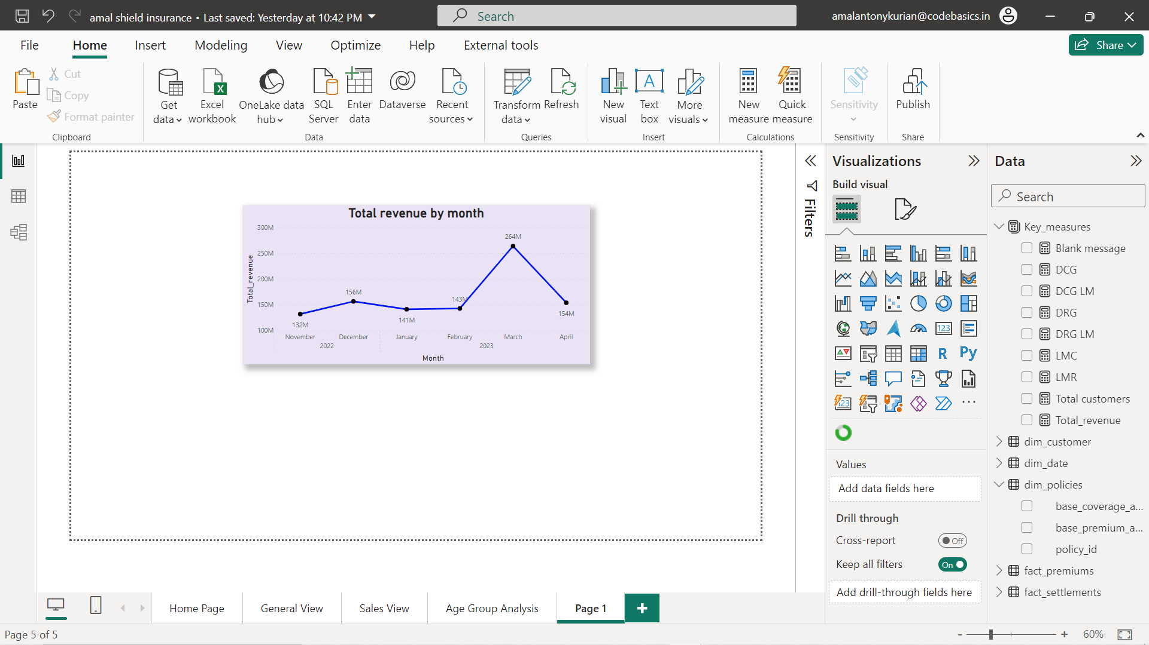
KEY INSIGHTS
MONTHLY TREND
In March 2023, Shield Insurance Company witnessed a notable upsurge in business, with significant increases in both customer acquisition and revenue generation.
The total number of customers surged to 7.1K, surpassing figures from any other month within the provided dataset.
The revenue generated during this month saw a rise to 264 million.

Slide 9
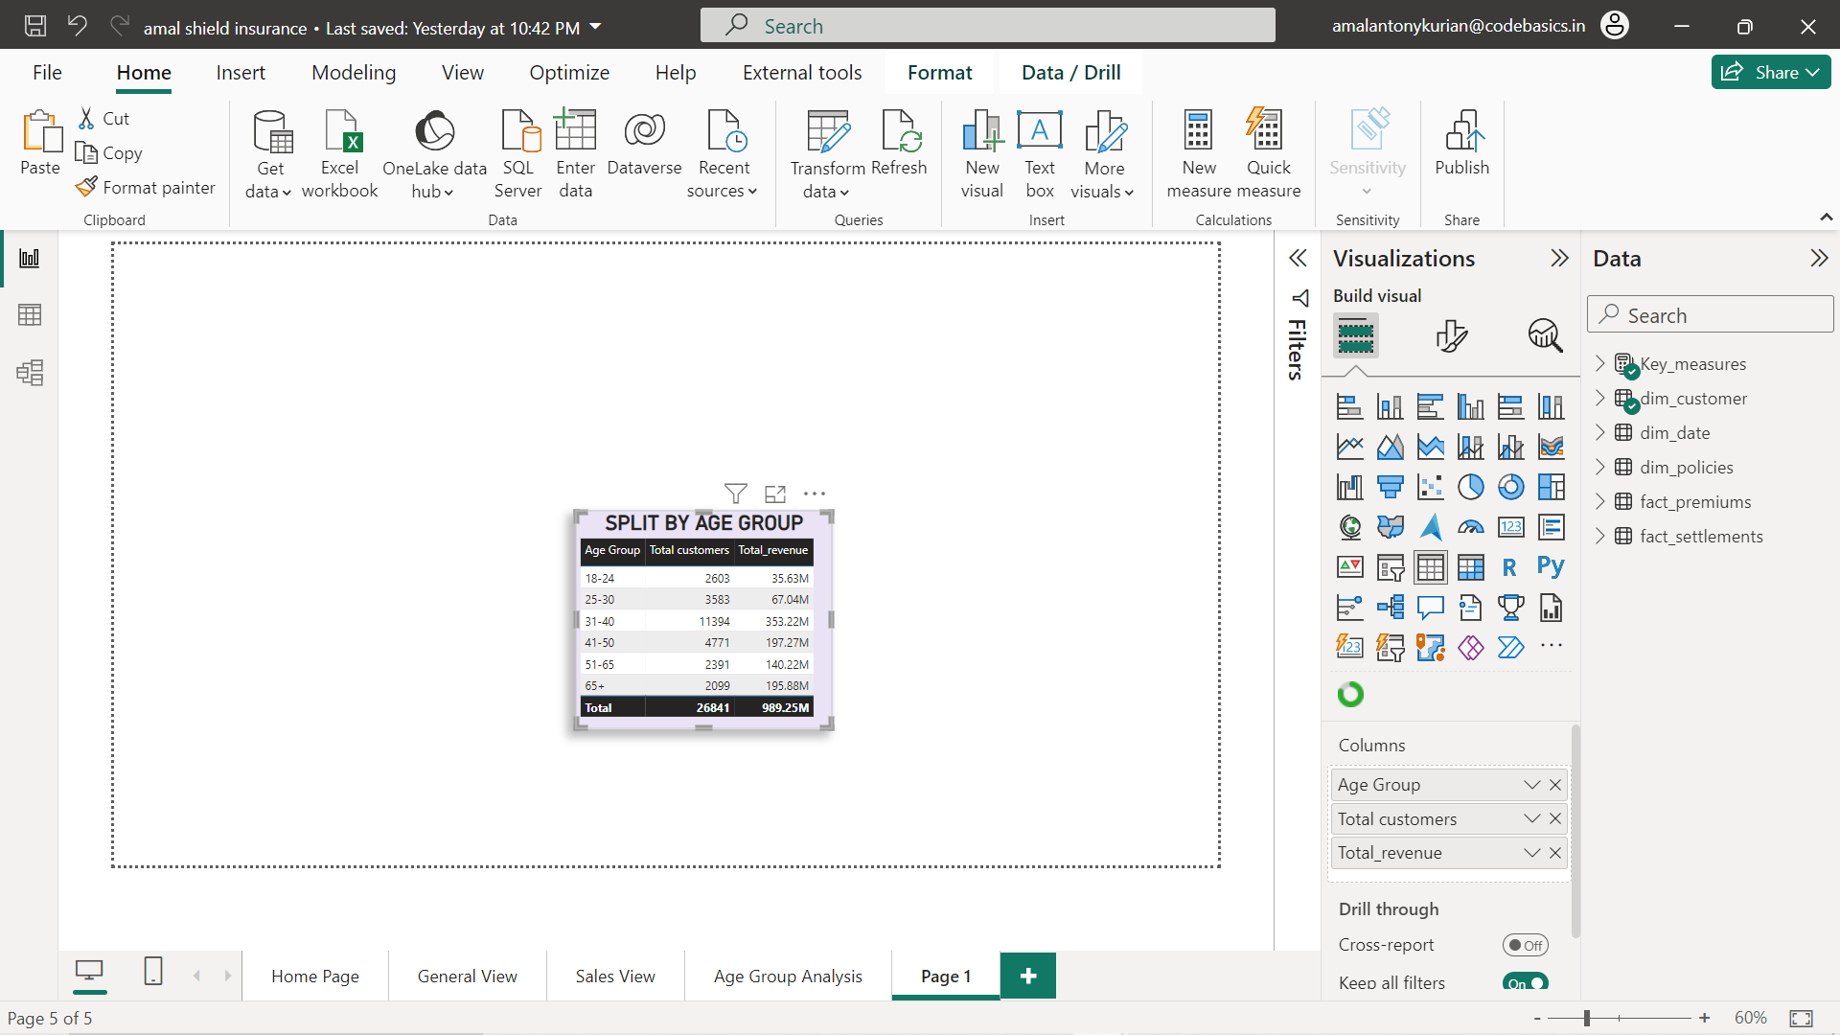
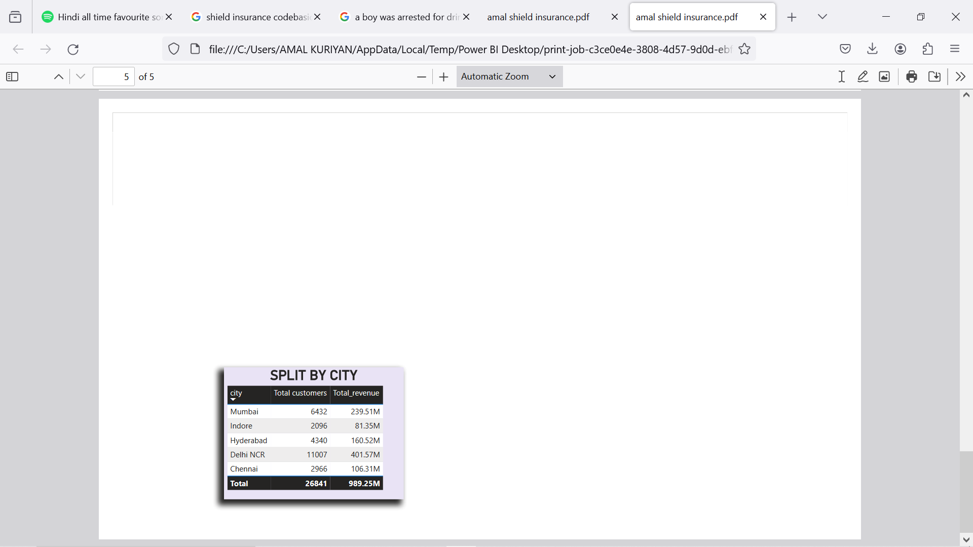
KEY INSIGHTS
AGE GROUP INSIGHTS
The primary contributors to the overall revenue from insurance policies are individuals aged 31-40, as they represent the largest portion of interested customers.
Additionally, customers aged 51 and above play a significant role in revenue generation.
CITY STATISTICS
Delhi NCR leads with the highest number of customers and revenue.
Mumbai, with a moderate customer base, contributes significantly to revenue, suggesting a lucrative market potential.
Despite their smaller customer counts, Hyderabad and Chennai play crucial roles in overall revenue generation.

Slide 10
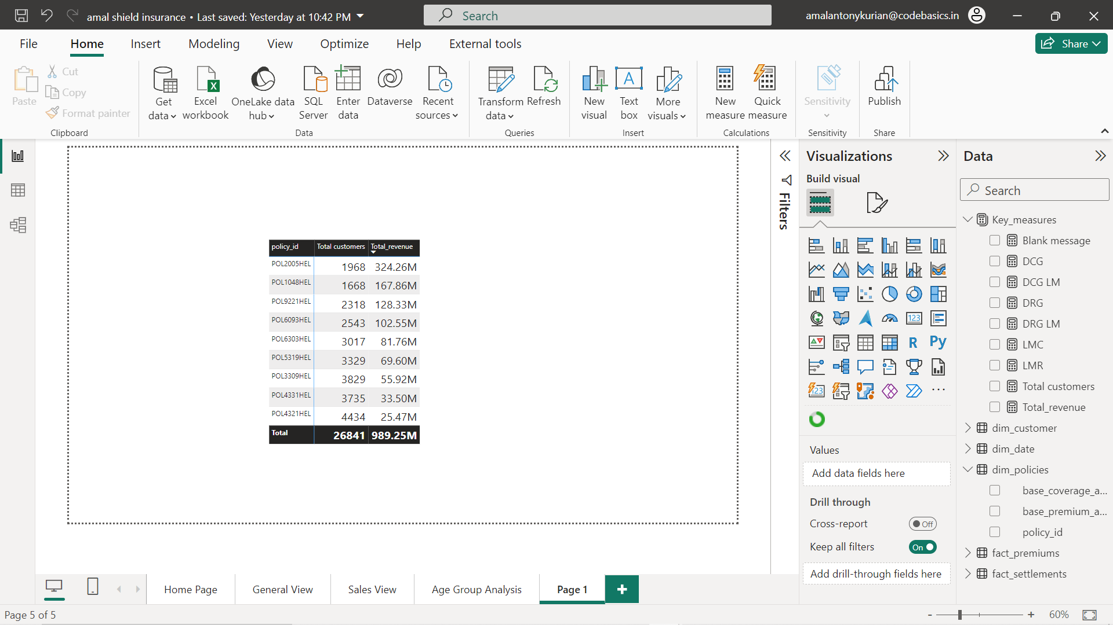
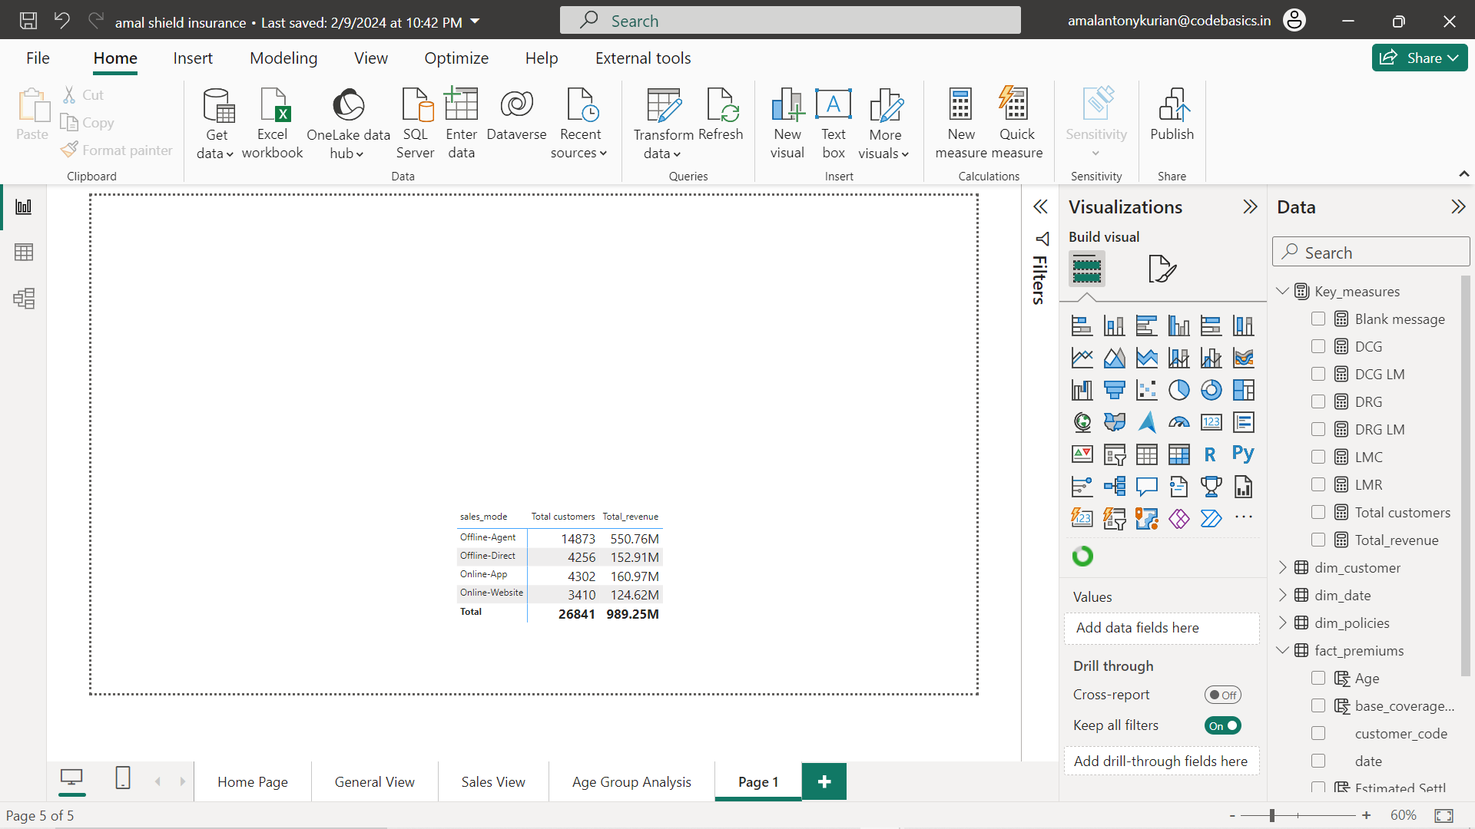
KEY INSIGHTS
POLICIES
Policy POL2005HEL achieved a revenue generation of 324.26M despite with 1968 customers.
Policy POL4321HEL has the highest number of customers of 4434 but it yields the lowest revenue generation of 25.47M
SALES MODE
Clearly we can see that offline agents play a big role in the sales category.
They are dominant in the no.of customers and total revenue generation.
More than 50% of the total customers and total revenue generation comes from offline agents.
On the other hand offline direct sales is not performing as expected.
Online app and website is showing a marginal growth and we can expect a good growth percentage in coming years.

Slide 11
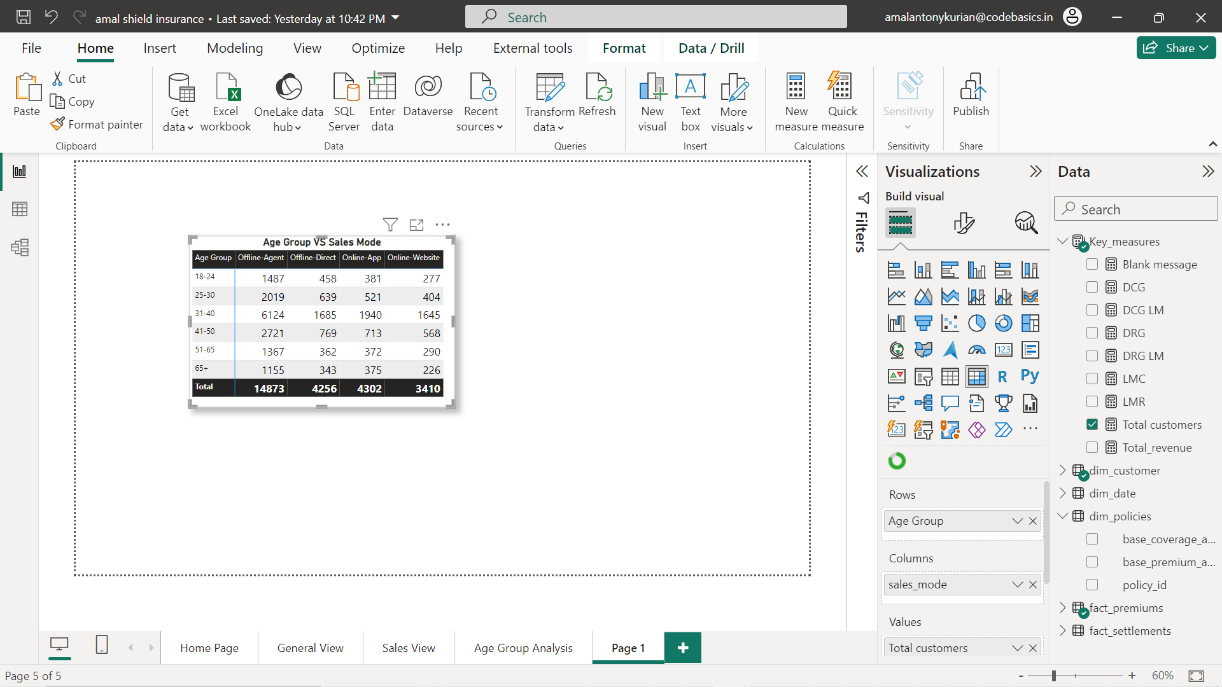
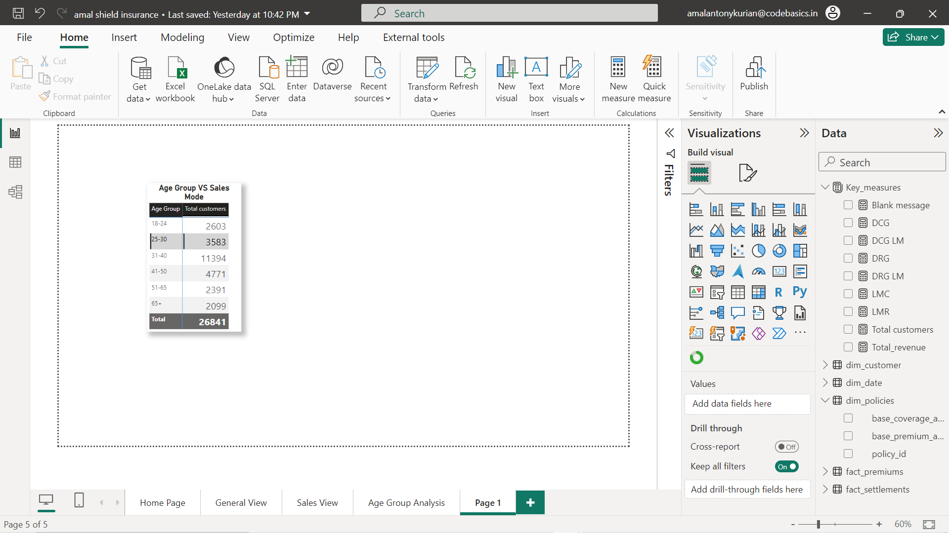
KEY INSIGHTS
AGE GROUP BASED STATISTICS
Considering all age categories we can see that most of the customers buy their policies via offline agent .
Out of which 31-40 age category has the highest no.of policies sold by offline agent about 6124 customers.
31-40 age category has the highest no.of customers -11294.
65+ ,51-65 age categories has the lowest no.of custmers ,2099 and 2391 respectively

Slide 12
SUGGESTIONS
Implement additional bonuses and enticing incentives for offline agents to enhance policy sales.
Enhance the user-friendliness of both the online website and app dashboards to drive an increase in online policy sales.
Introduce more captivating policies tailored for age categories with high revenue, such as those aged 31-40.
Introduce additional medical packages targeting age categories 51-65 and 65+, considering their higher revenue generation potential.
Analyze the month with the lowest revenue generation and the month with the fewest incoming customers, identifying the underlying causes and proposing solutions.
Conduct an in-depth analysis to understand the reasons behind the significant increase in the number of customers and revenue generation observed in March. Utilize these findings to inform strategies for upcoming months.

Slide 13
THANK YOU

